Slide 1

ALICE 13TeV
$\frac{1}{N_{trig}}\frac{d^{2}N_{pair}}{dΔηdΔφ}={\left.B\left(0,0\right)\frac{S\left(Δη,Δφ\right)}{B\left(Δη,Δφ\right)}\right|}_{p_{T, trig} , p_{T, assoc}}$ (3.1)
$\frac{1}{N_{trig}}\frac{dN_{pair}}{dΔφ}=\int_{1.6<\left|Δ η\right|<1.8}{\left(\frac{1}{N_{trig}}\frac{d^{2}N_{pair}}{dΔηdΔφ}\right)\frac{1}{δ_{Δη}}dΔη −C_{ZYAM}} (3.2)$
$δ_{Δη}=2×\left(1.8−1.6\right)=0.4 →$ normalization factor
$Y^{ridge}=\int_{\left|Δ φ\right|<\left|Δ φ_{min}\right|}{\frac{1}{N_{trig}}\frac{dN_{pair }}{dΔφ}dΔφ} (3.3)$
The minimum yield($C_{ZYAM}$) at $Δφ=Δφ_{min}$
Near-side : $\left|Δ φ\right|<1.28 →$(3.4) 위
$Y^{near} →$near-side jet-like peak yield

Slide 2

CMS, ALICE
Long-range : ALICE $→ 1.6<\left|Δ η\right|<1.8$
CMS $→ 2 <\left|Δ η\right|< 4$
High multiplicity : ALICE $→0\sim 0.1\%$
CMS $→ N_{trk}^{offline}≥105 →0\sim 0.03\%$
지금까지 CMS의 $Δ φ$ Correlation을 그릴 때에, 그냥 적분을 하였음.
ALICE의 (3.2)의 식을 이용하여 적분하여 다시 그려봐야 함.($δ_{Δη}$)
CMS의 $C_{ZYAM}$은 있지만, ALICE는 $C_{ZYAM}$이 없어 $1<p_{t}<4을$ 그릴 수 없음.

Slide 3
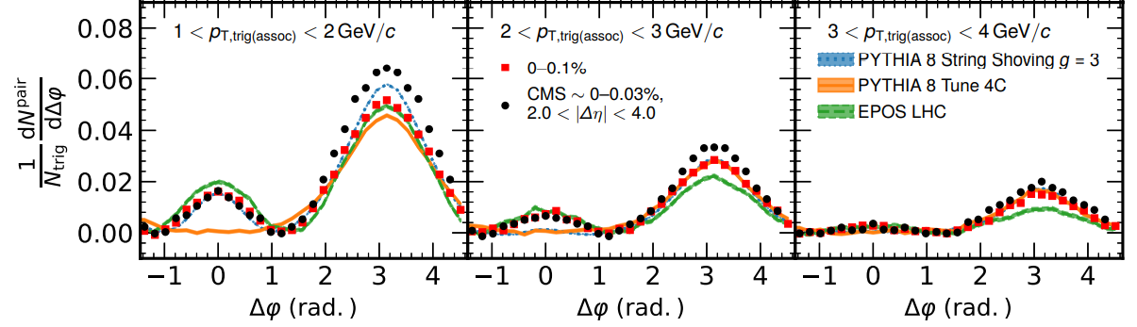
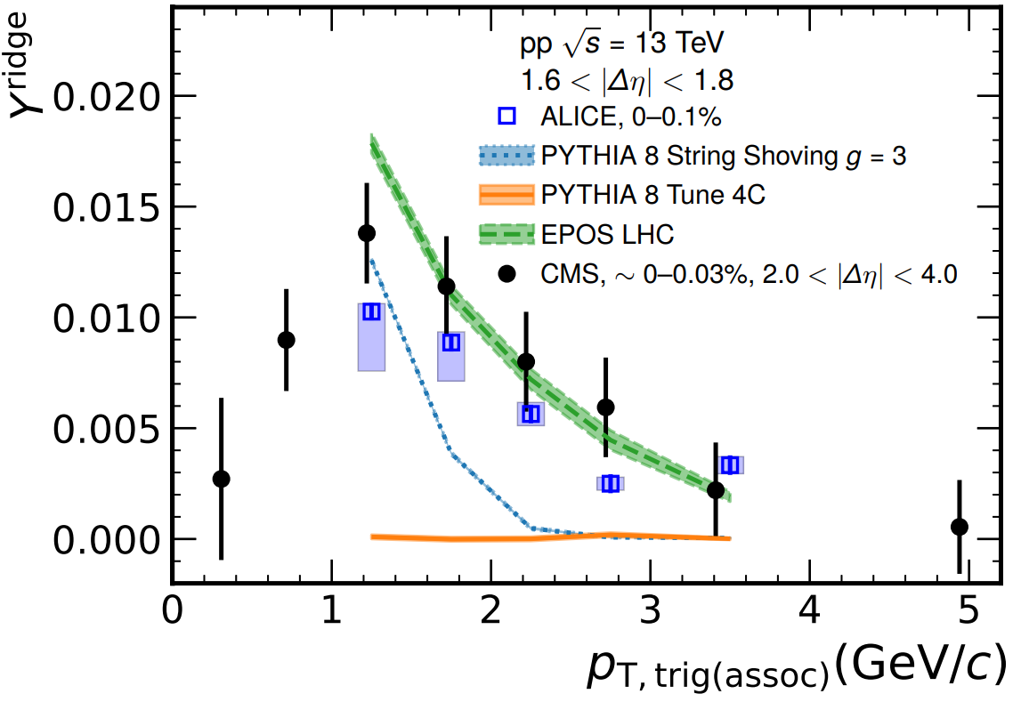

현재 계산식
$Δφ$Correlation : $\frac{1}{N_{trig}}\frac{dN_{pair}}{dΔφ}=\int_{1.6<\left|Δ η\right|<1.8}{\left[\int{\left(\frac{d^{2}F}{p_{T}dp_{T}dΔηdΔφ}\right)}\frac{1}{δ_{Δη}}p_{T}dp_{T}\right]dΔη −C_{ZYAM}}$
$Y^{ridge}=\int_{−1.28<\left|Δ φ\right|<1.28}{\left[\int_{1.6<\left|Δ η\right|<1.8}{\left(\int{\frac{d^{2}F}{p_{T}dp_{T}dΔηdΔφ}} p_{T}dp_{T}\right)\frac{1}{δ_{Δη}}dΔη}\right]dΔφ }$

Slide 4

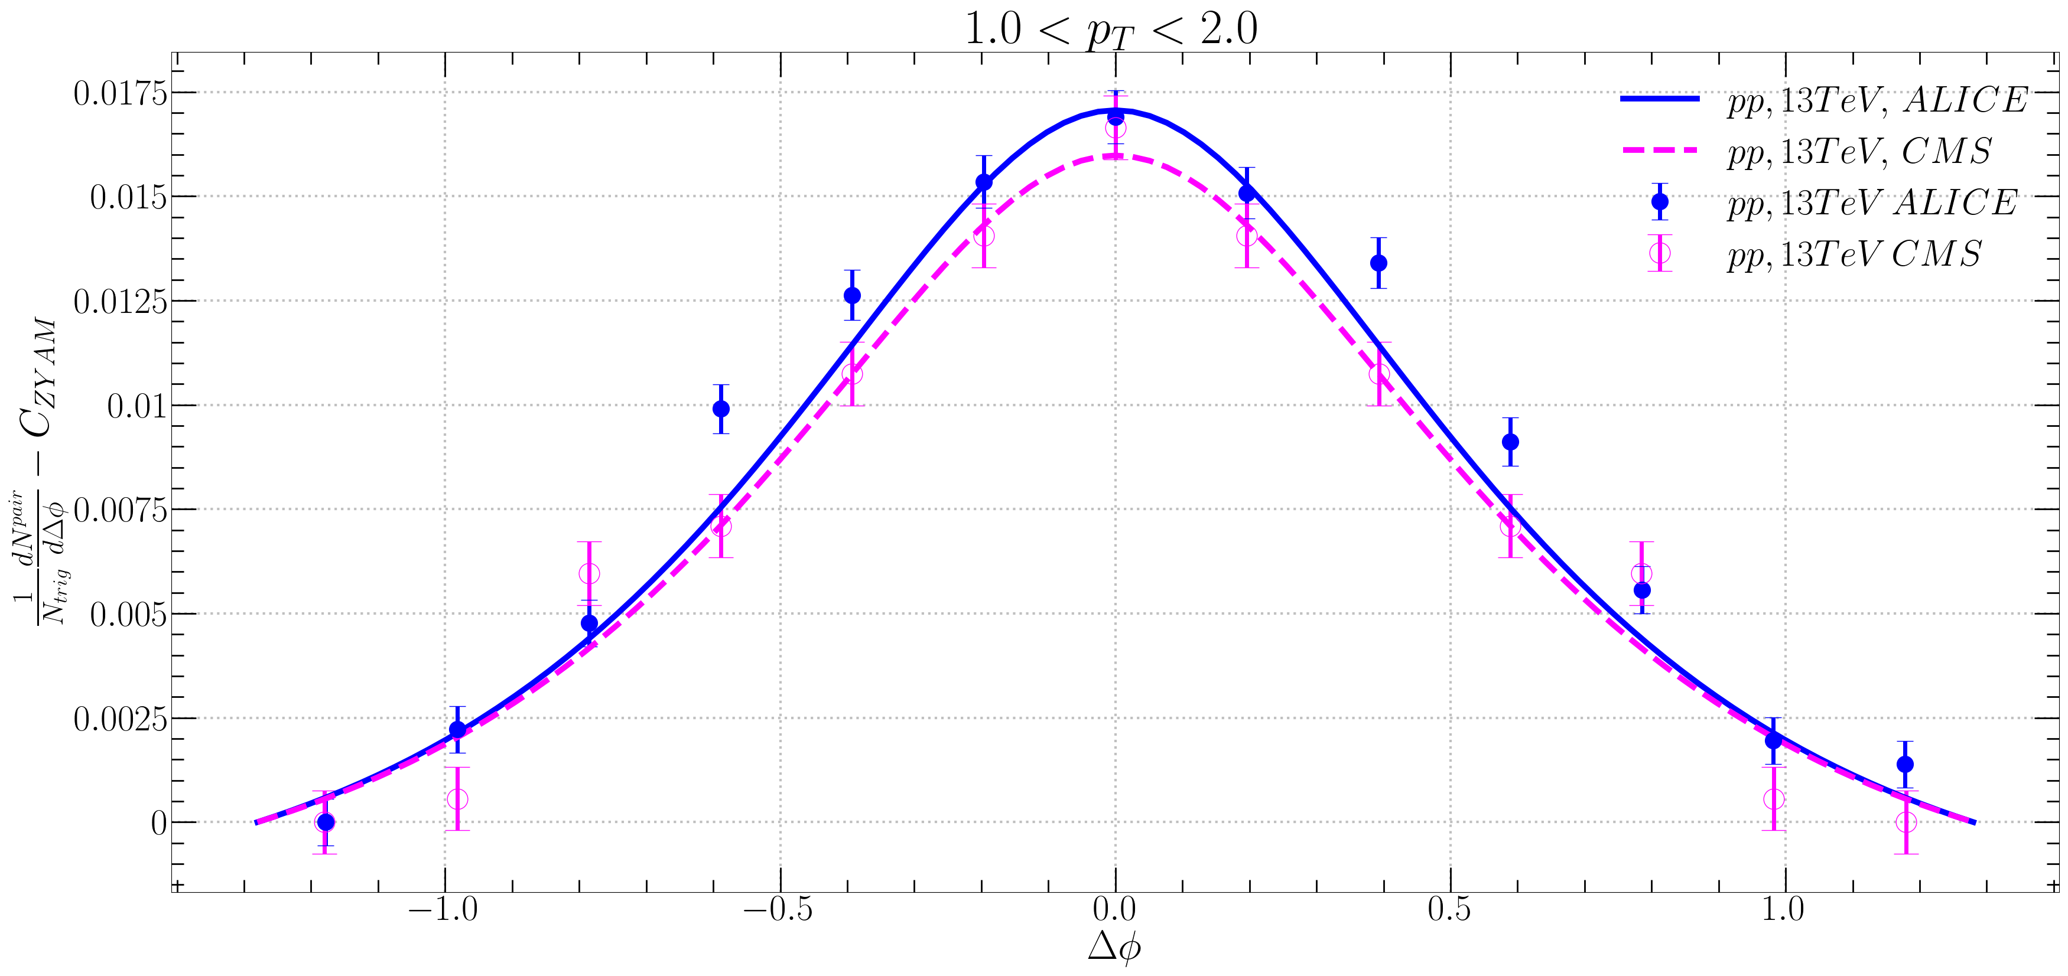

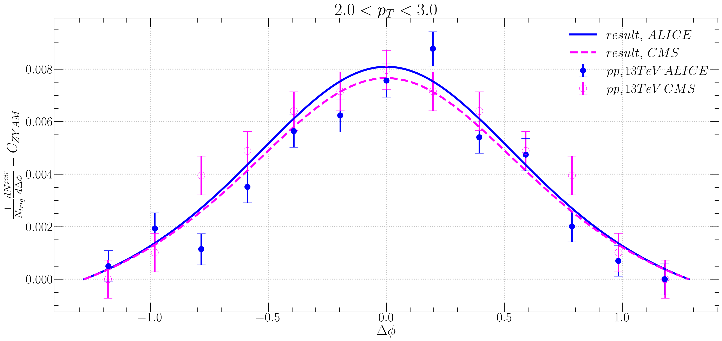


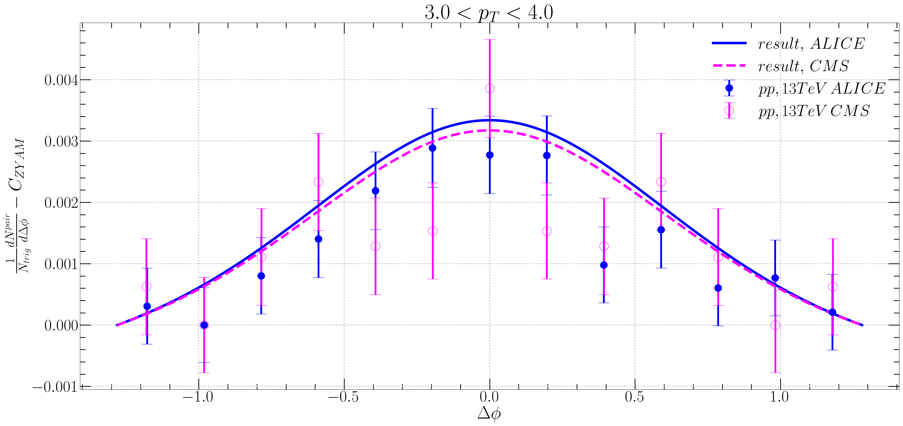




21.08.26 Fitting $$a=4 \\ T=0.63 GeV \\ q=0.9 GeV \\ m_{d}=1 GeV \\ \sqrt{S_{nn}}=13000 GeV \\ A_{ridge}=0.040276$$
$Δφ$ Correlation
$f_{R}\left\langle N_{k}\right\rangle =0.585e^{0.81p_{T}}$

Slide 5
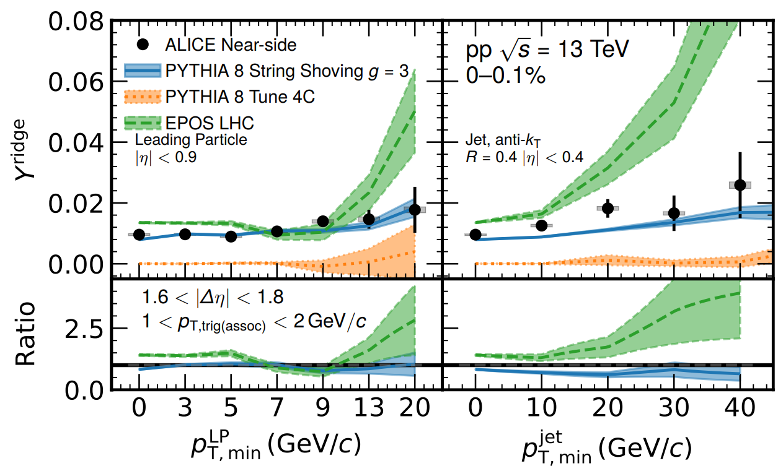
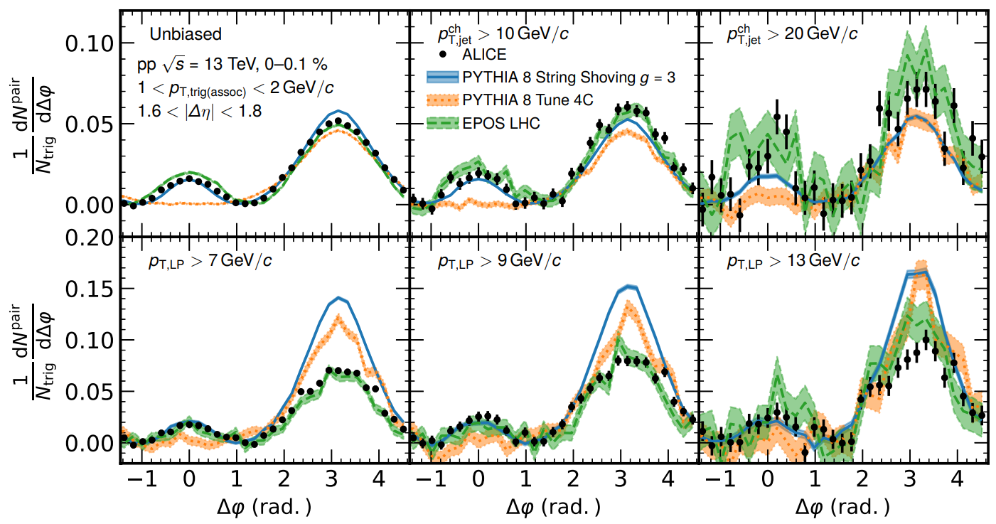
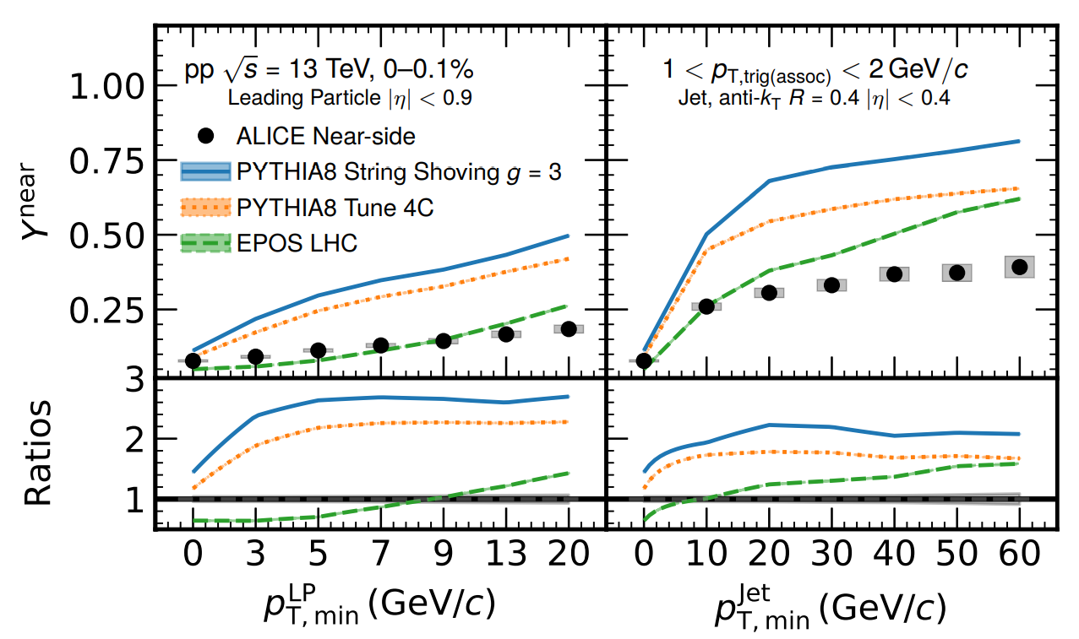

Slide 6
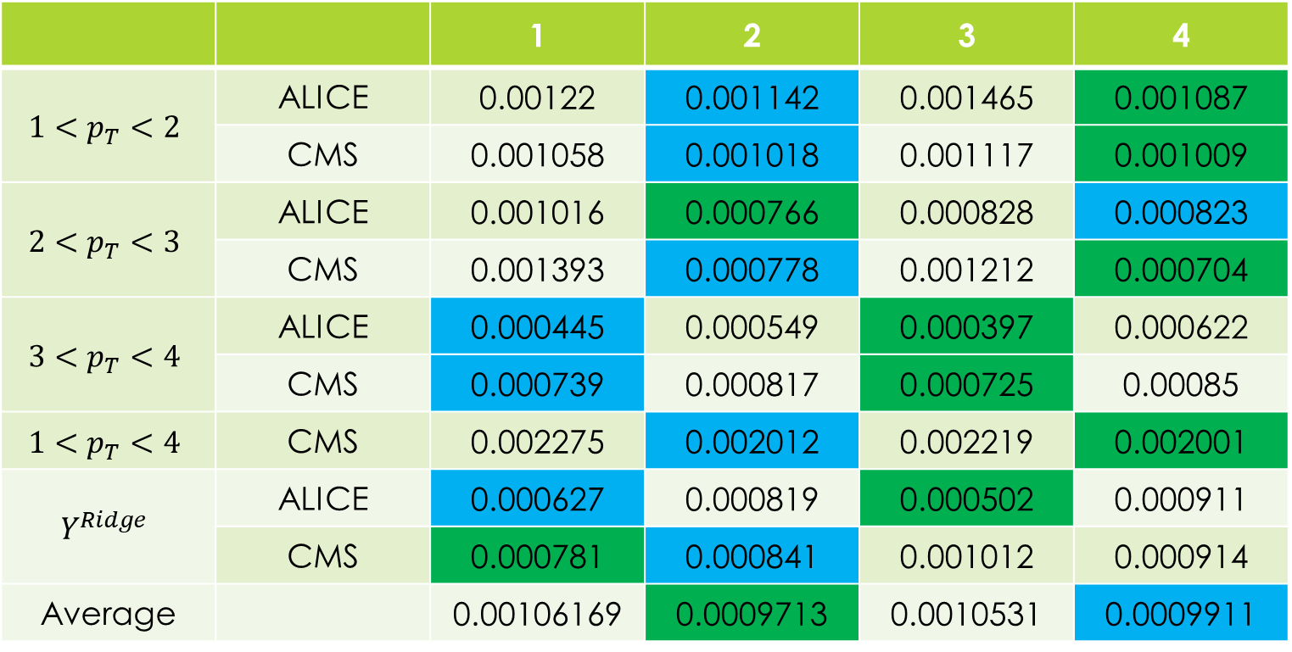
Standard Deviation
 |  | 1 | 2 | 3 | 4
$$1<p_{T}<2$$ | ALICE | 0.00122 | 0.001142 | 0.001465 | 0.001087
 | CMS | 0.001058 | 0.001018 | 0.001117 | 0.001009
$$2<p_{T}<3$$ | ALICE | 0.001016 | 0.000766 | 0.000828 | 0.000823
 | CMS | 0.001393 | 0.000778 | 0.001212 | 0.000704
$$3<p_{T}<4$$ | ALICE | 0.000445 | 0.000549 | 0.000397 | 0.000622
 | CMS | 0.000739 | 0.000817 | 0.000725 | 0.00085
$$1<p_{T}<4$$ | CMS | 0.002275 | 0.002012 | 0.002219 | 0.002001
$$Y^{Ridge}$$ | ALICE | 0.000627 | 0.000819 | 0.000502 | 0.000911
 | CMS | 0.000781 | 0.000841 | 0.001012 | 0.000914
Average |  | 0.00106169 | 0.0009713 | 0.0010531 | 0.0009911

Slide 7

Mistake
$y_{b}=\cosh^{−1}{\frac{\sqrt{S_{nn}}}{2m_{π}}} → y_{b}=\cosh^{−1}{\frac{\sqrt{S_{nn}}}{2m_{p}}}$

Slide 8
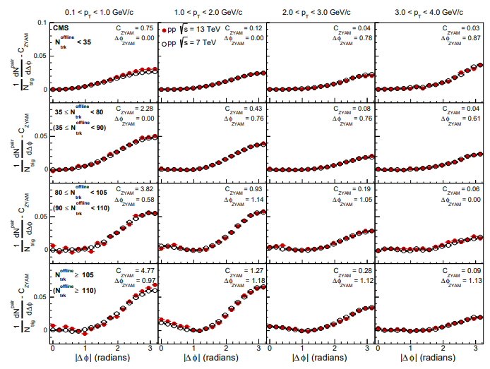

CMS 7TeV
1510.03068 – 5 page last paragraph
‘Nearly no center-of-mass energy dependence is observed for the correlations in any $p_{T}$ or multiplicity range as shown in Fig.2.

Slide 9
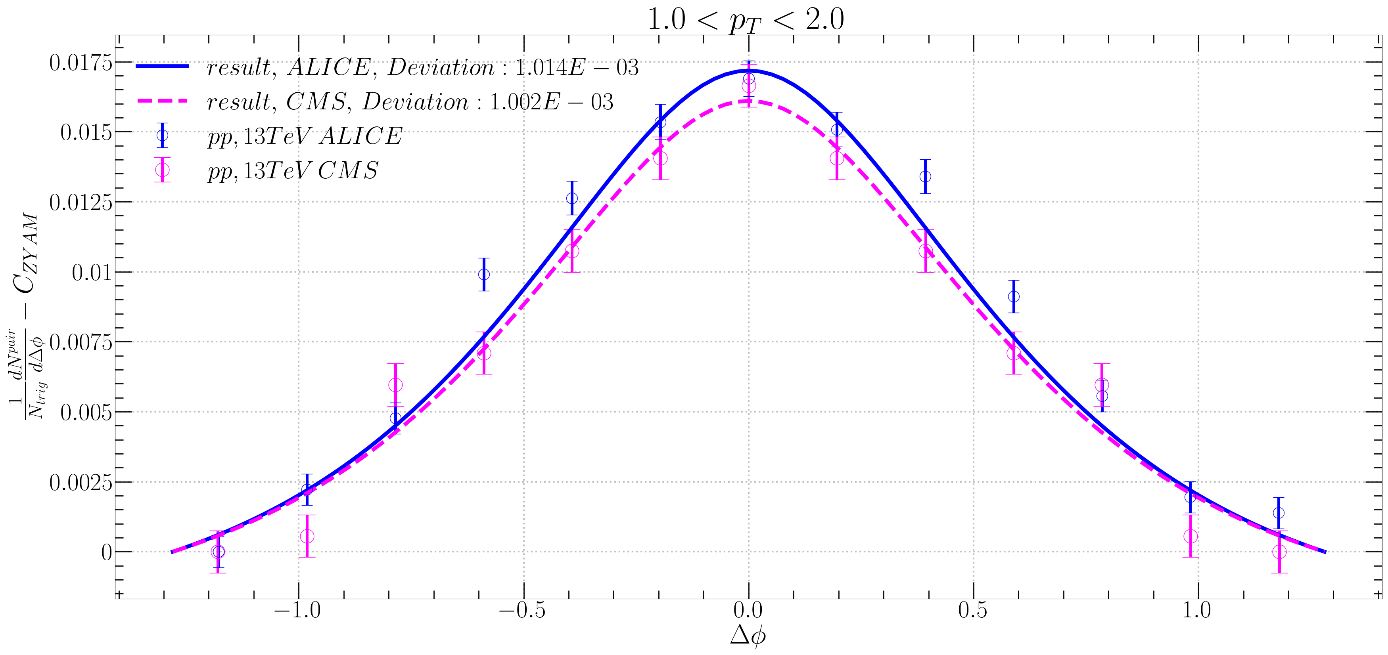
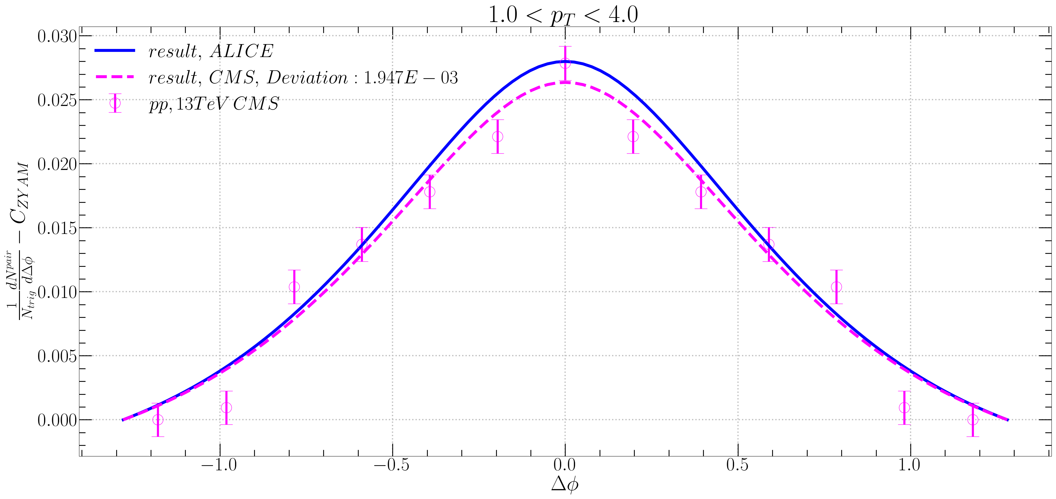
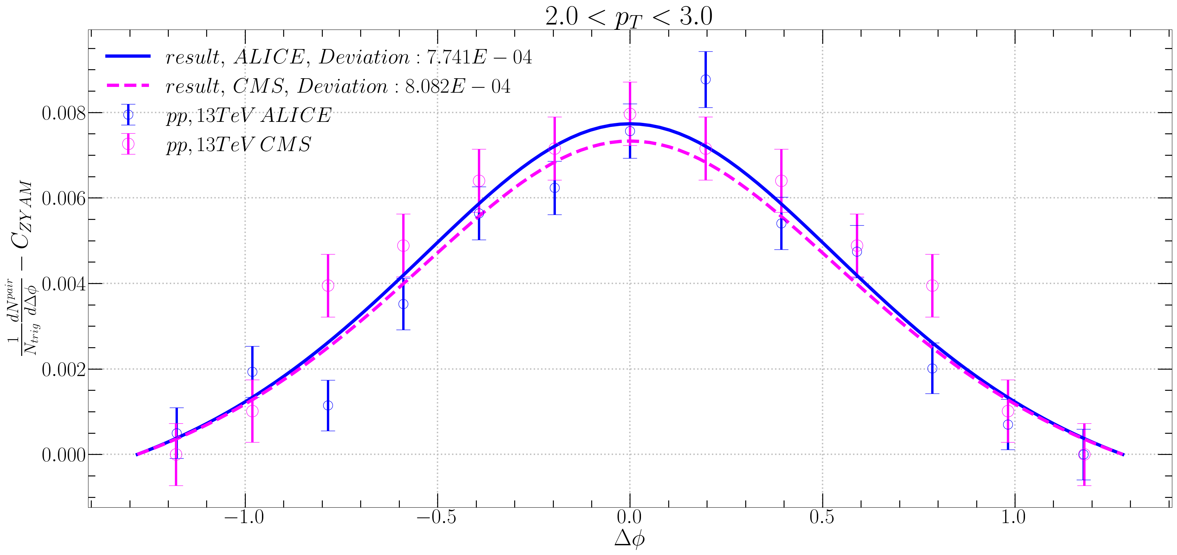
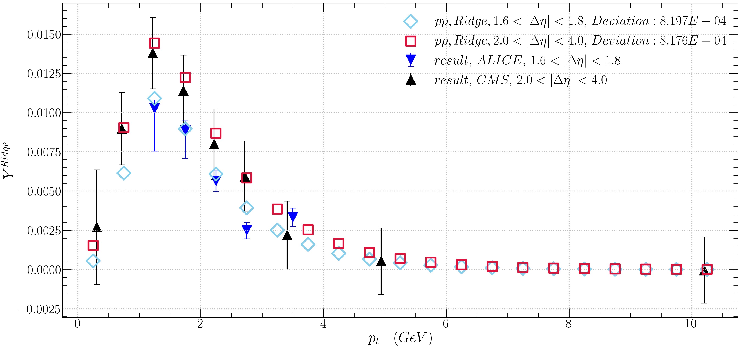
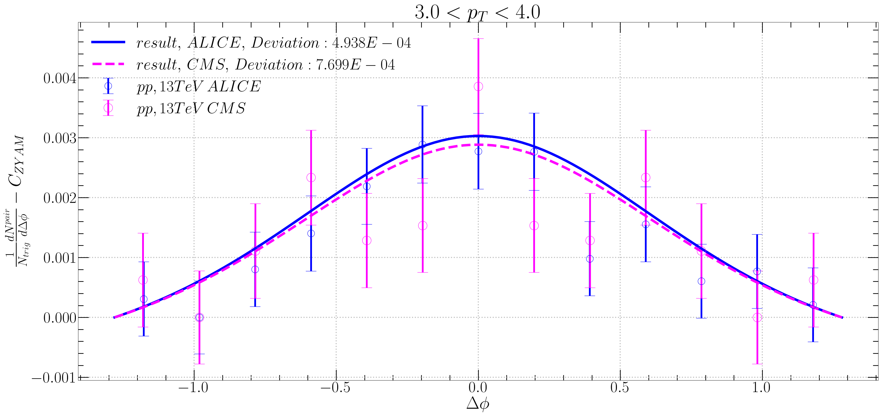

21.09.06 Fitting $$a=0.5 \\ T=0.65 GeV \\ q=0.9 GeV \\ m_{d}=1 GeV \\ \sqrt{S_{nn}}=13000 GeV \\ f_{R}\left\langle N_{k}\right\rangle =0.66e^{0.71p_{T}}$$

Slide 10
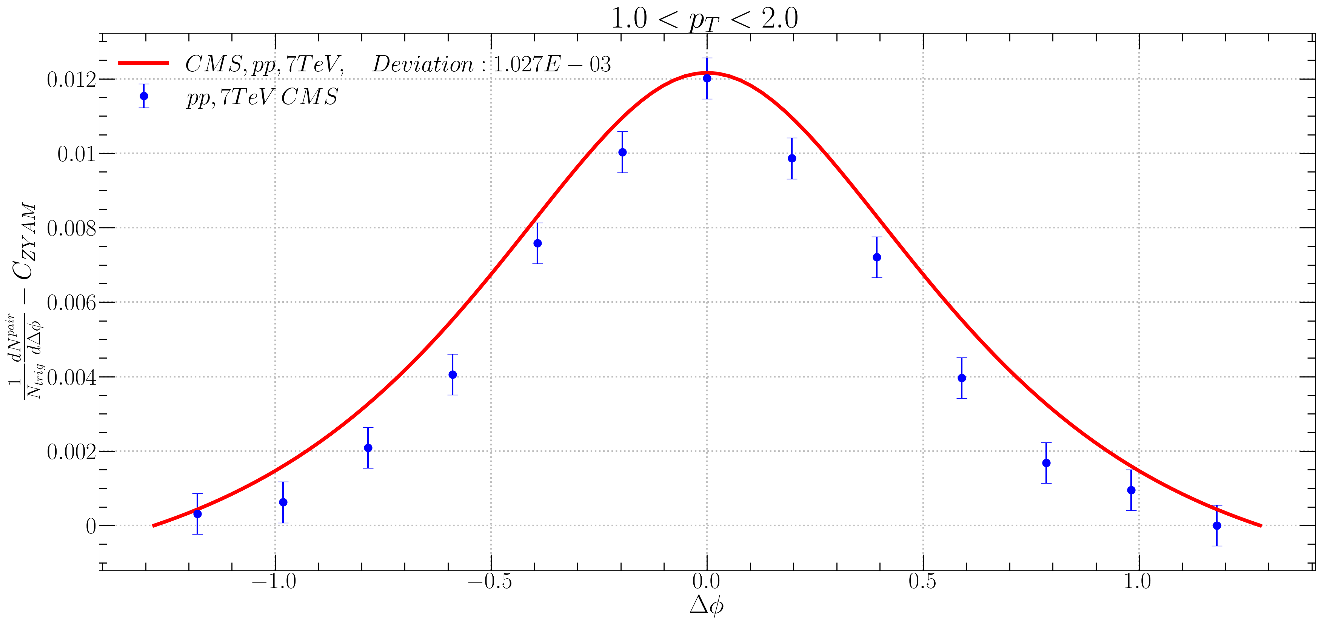
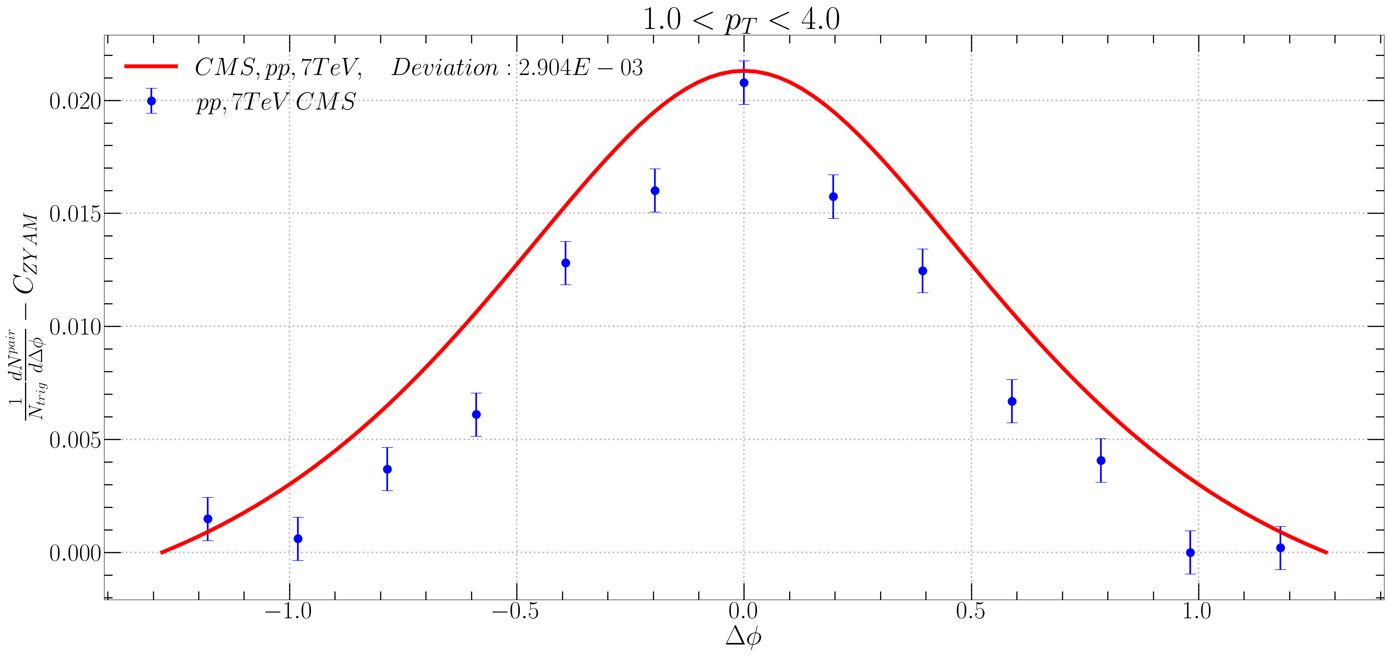
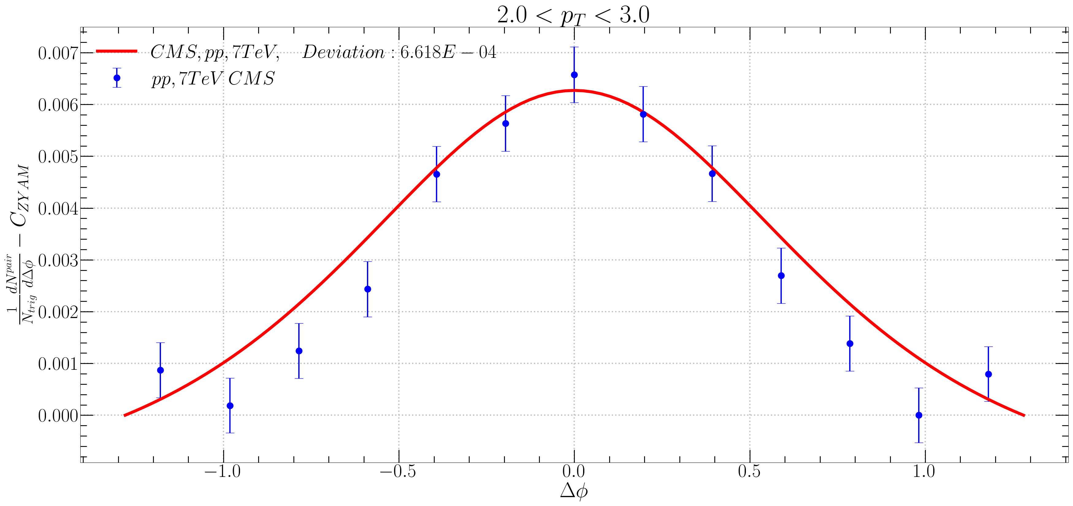
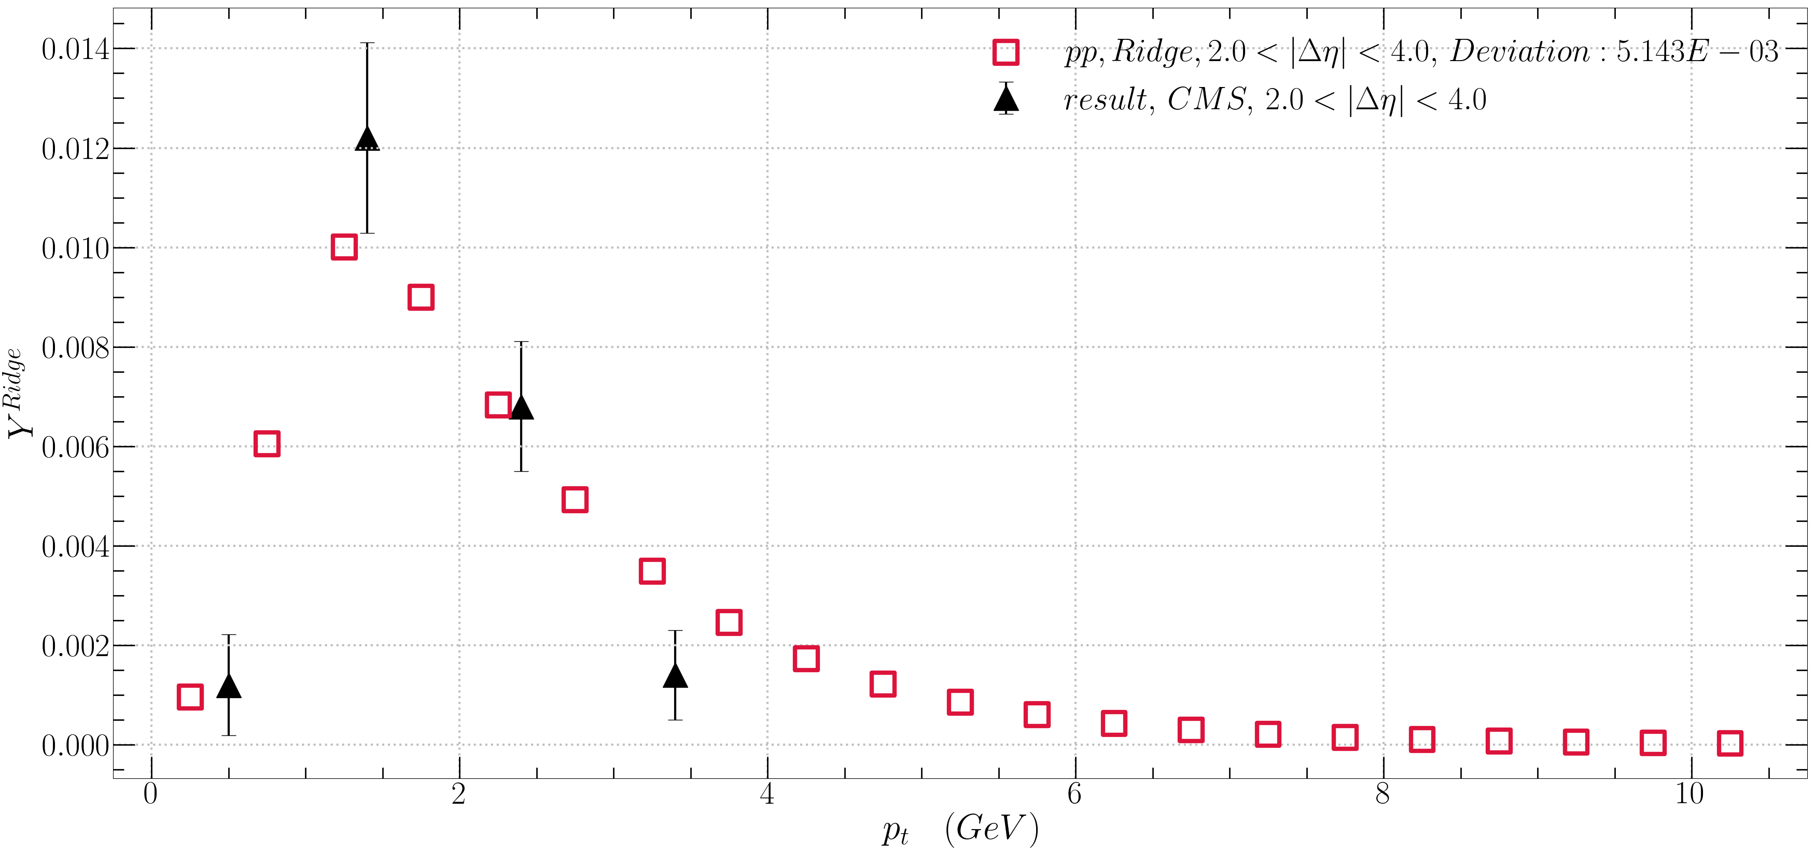
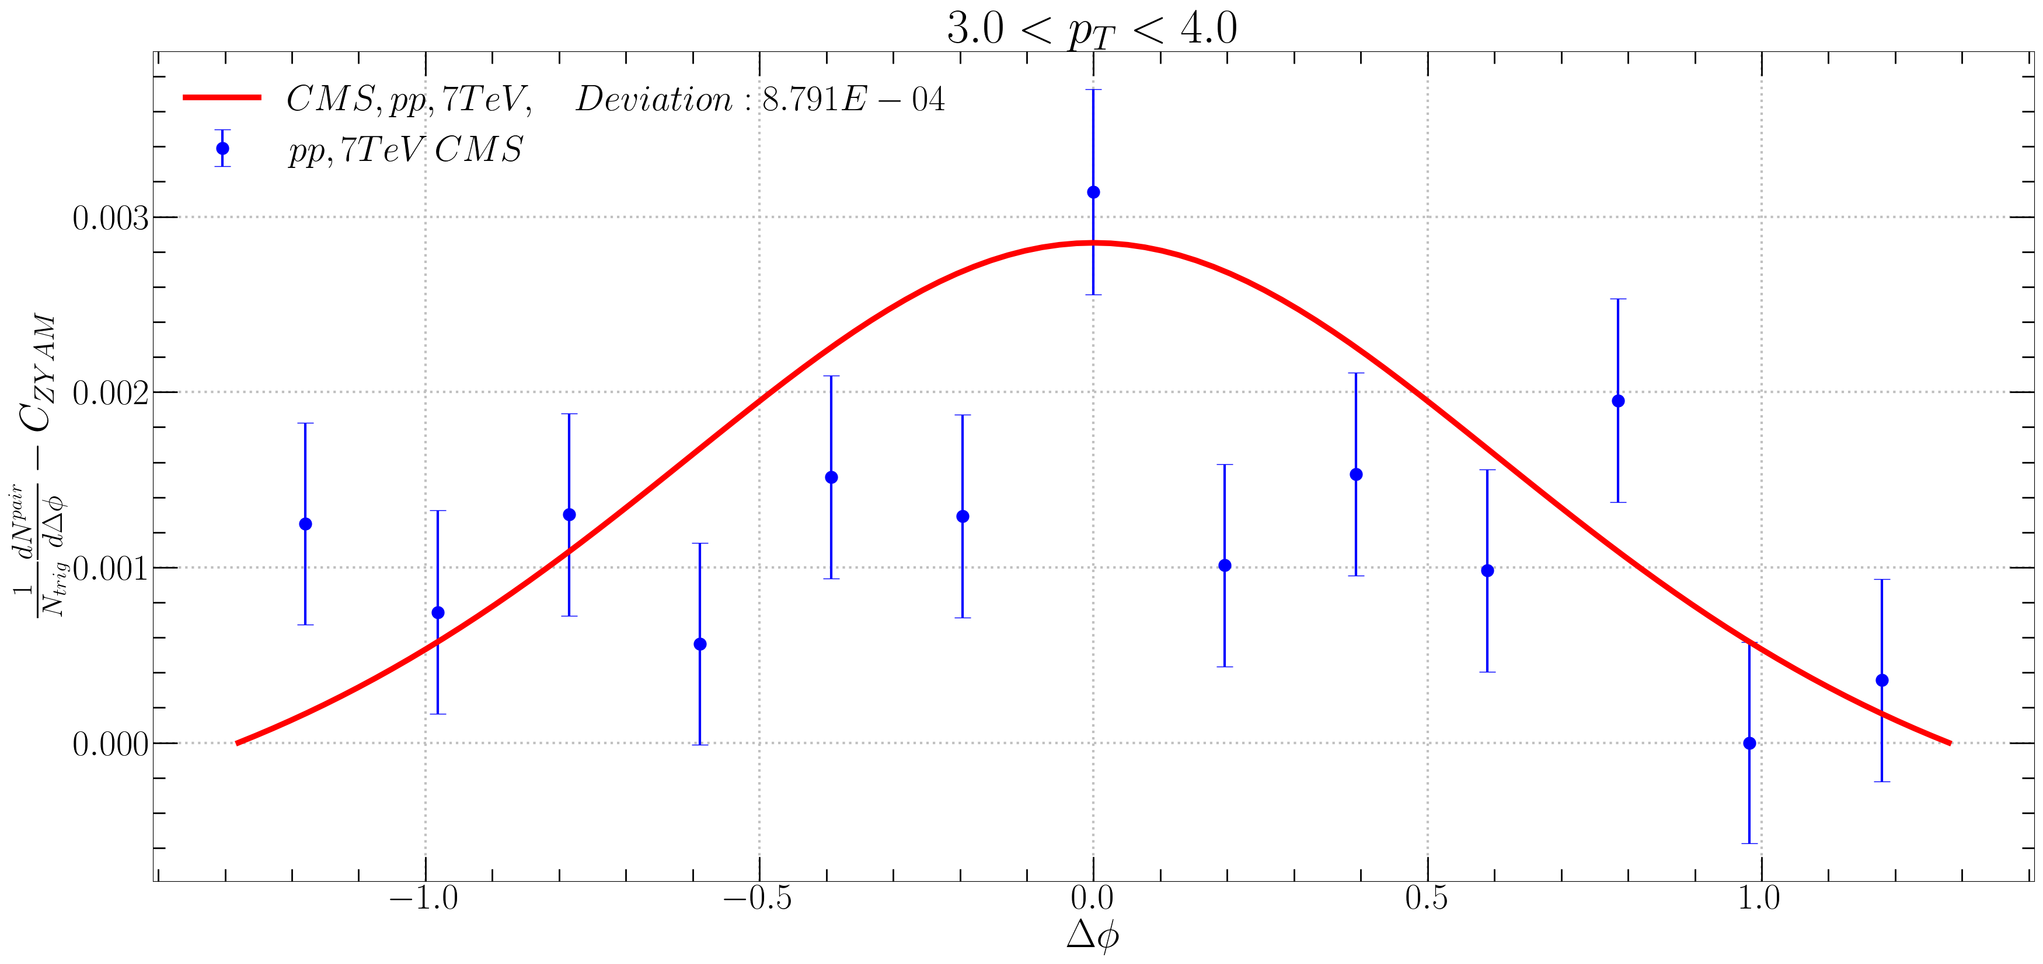

In CMS 7TeV
21.09.06 Fitting $$a=0.5 \\ T=0.62 GeV \\ q=0.87 GeV \\ m_{d}=1 GeV \\ \sqrt{S_{nn}}=7000 GeV \\ f_{R}\left\langle N_{k}\right\rangle =0.32e^{0.93p_{T}}$$

Slide 11
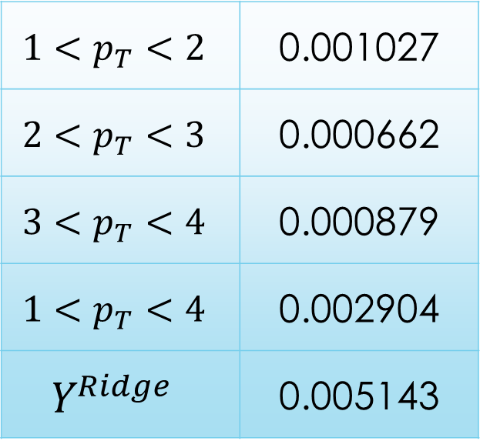
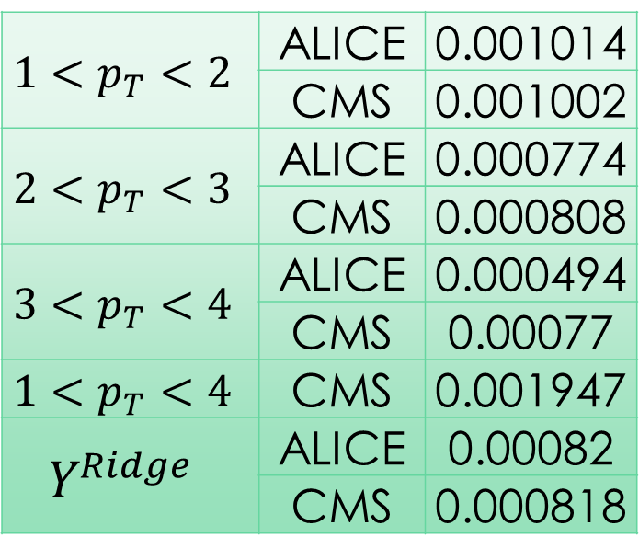
Deviation
13 TeV
7 TeV
$$1<p_{T}<2$$ | ALICE | 0.001014
 | CMS | 0.001002
$$2<p_{T}<3$$ | ALICE | 0.000774
 | CMS | 0.000808
$$3<p_{T}<4$$ | ALICE | 0.000494
 | CMS | 0.00077
$$1<p_{T}<4$$ | CMS | 0.001947
$$Y^{Ridge}$$ | ALICE | 0.00082
 | CMS | 0.000818
$$1<p_{T}<2$$ | 0.001027
$$2<p_{T}<3$$ | 0.000662
$$3<p_{T}<4$$ | 0.000879
$$1<p_{T}<4$$ | 0.002904
$$Y^{Ridge}$$ | 0.005143

Slide 12
